Slide 1
Software engineering module – IV Designing
Semester VI B.Tech. CSE Viswajyothi College of Engineering

Slide 2
Design
Provides structure to any artifact
Decomposes system into parts, assigns responsibilities, ensures that parts fit together to achieve a global goal
Design refers to both an activity and the result of the activity

Slide 3
Analysis and Design
Analysis:
To understand the problem.
Eliminate any deficiencies in the requirement specification.
Design
Produce a model that will provide a seamless transition to the coding phase
The last software engineering action within the modeling activity and sets the stage for construction

Slide 4
Design Activity
Activity that acts as a bridge between requirements and the implementation of the software
An iterative process through which requirements are translated into a “blueprint” for constructing the software.
Activity that gives a structure to the artifact
e.g., a requirements specification document must be designed
must be given a structure that makes it easy to understand and evolve

Slide 5
Software design
The customer requirements, as described in the SRS document => a form (a set of documents) that is suitable for implementation in a programming language.
Design activities can be broadly classified into two important parts:
Preliminary (or high-level or Architectural) Design and
Detailed design

Slide 6
Contnd..
Preliminary or High-Level Design
Identification of different modules
The control relationships among them and
The definition of the interfaces among these modules
Outcome of high-level design is called the program structure or software architecture.
Notations
Tree-like diagram called the structure chart to represent the control hierarchy in a high-level design.

Slide 7
Contnd..
Detailed design,
The data structure
The algorithms of the different modules
The outcome of the detailed design stage is
The module-specification document.

Slide 8
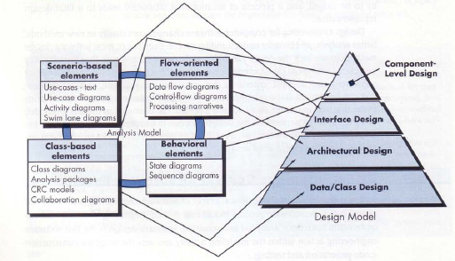
Requirements Model into the Design Model

Slide 9
Contnd..
The data/class design
Transforms class models into design class realizations and the requisite data structures required to implement the software.
The architectural design defines
The relationship between major structural elements of the software,
The architectural styles and design patterns that can be used to achieve the requirements defined for the system, and
The constraints that affect the way in which architecture can be implemented

Slide 10
Contnd..
The interface design
Describes how the software communicates with systems that interoperate with it, and with humans who use it.
Implies a flow of information and a specific type of behaviour.
The component-level design transforms
Structural elements of the software architecture into a procedural description of software components.

Slide 11
Items developed during the software design phase
Different modules required to implement the design solution.
Control relationship among the identified modules.
Call relationship or invocation relationship among modules.
Interface among different modules.
Identifies the exact data items exchanged among the modules.
Data structures of the individual modules.
Algorithms required to implement each individual module

Slide 12
Objectives of Software Design
Design for Quality
Quality is fostered in software engineering.
The only way to accurately translate stakeholder’s requirements into a finished software product or system.
Serves as the foundation for all the software engineering and software support activities that follow.

Slide 13
Contnd..
Design for Change
Way to design software that can be modified easily as requirements changes.
Care from initial stages
Not only concentrate on what is presently needed but also consider the expected or possible evolution of the system.
Previous experience of software engineer & Deep understanding of the problem domain by the end user.
Importance:
A minor mistake in the design based on current need.
Accommodating changes may clutter the design.

Slide 14
Contnd..
Changes
Algorithm
Data Representation
Underlying abstract machine
Peripheral devices
Social Environment
Due to development process

Slide 15
Contnd..
Product Family
View several end products as a family of products that share a single architecture that is reused in different contexts, giving rise to different designs.
Every version constitutes an individual product
Set of versions constitutes a family
Designs a common architecture for all members of the family jointly.
E.g. DBMS runs on different machines (OS) for various configurations.
Avoids the cost of designing the common parts separately.

Slide 16
Sequential completion: the wrong way
Design first member of product family
Modify existing software to get next member products
Requirements
Requirements
Requirements
intermediate
design
1
1
1
2
final
product
2
2
Version 1
3
Version 1
3
3
4
6
4
4
Version 1
Version 2
5
7
Version 3
Version 2
5

Slide 17
How to do better
Anticipate definition of all family members
Identify what is common to all family members, delay decisions that differentiate among different members

Slide 18
Function-Oriented Design
A system is viewed as something that performs a set of functions.
Starting at this high-level view of the system, each function is successively refined into more detailed functions.
Eg. Create-new-library-member
assign-membership-number
create-member-record
print-bill

Slide 19
Contnd..
The system state is centralized and shared among different functions.
E.g. data such as member-records is available for reference and updation to several functions such as:
create-new-member
delete-member
update-member-record

Slide 20
Object-oriented design
The system is viewed as collection of objects (i.e. entities).
The state is decentralized among the objects and each object manages its own state information.
Eg. in a Library Automation Software, each library member may be a separate object with its own data and functions to operate on these data.
The functions defined for one object cannot refer or change data of other objects.
Objects have their own internal data which define their state.
Similar objects constitute a class. In other words, each object is a member of some class.
Classes may inherit features from super class.
Conceptually, objects communicate by message passing.

Slide 21
Function-oriented vs. object-oriented design approach
In OOD, the basic abstraction are not real-world functions.
Eg. In OOD, an employee pay-roll software is not developed by designing functions such as update-employee-record, get-employee-address, etc. but by designing objects such as employees, departments, etc.
In OOD, state information is not represented in a centralized shared memory but is distributed among the objects of the system.
Eg. While developing an employee pay-roll system, the employee data such as the names of the employees, their code numbers, basic salaries, etc. are usually implemented as global data in a traditional programming system; whereas in an object-oriented system these data are distributed among different employee objects of the system.

Slide 22
Contnd..
Function-oriented techniques group functions together if, as a group, they constitute a higher-level function.
Object-oriented techniques group functions together on the basis of the data they operate on.
It is not necessary an object-oriented design be implemented by using an object-oriented language only.
They do not replace each other but complement each other in some sense.

Slide 23
Modularization Techniques
A systematic approach to the design of product families.
Aspects
Problem of defining the overall structure of the architecture in terms of relationships among modules. (Architectural Design)
Design of each module, to which the principle of information hiding is applied. (Detailed Design)
A progress in which the interplay between these two activities take place in a flexible way.
Textual or graphical notations are used.

Slide 24
Contnd..
Module structure and its representation
Interface and information hiding
Design notations
Categories of modules
Specific techniques to accommodate change,
Stepwise refinement
Top-down and bottom-up design

Slide 25
The Module Structure and its Representation
Module
A well defined component of a software system.
A provider of computational resources or services.
A collection of routines, data, type definitions, or a mixture of all.
Overall module structure and relations must be defined.
Use of identified module relations
By a Manager: to monitor the development of the system
As a guideline for assigning work to programmers according to their skill and experience.

Slide 26
Contnd..
Mathematical relations
S = {M1,M2,………,Mn}
A relation r on S is a subset of SxS
If two Modules Mi and Mj are in S and the pair <Mi, Mj> is in r by using the infix notation Mi r Mj.
Relations are irreflexive ie. Mi r Mi cannot hold for any module Mi in S.
Transitive Closure (r+)
Mi r+ Mj if and only if Mi r Mj (Direct)or there is an element Mk in S such that Mi r Mk and Mk r Mj (Indirect).
E,g. CALL relation
Hierarchy
There are no two elements Mi, Mj such that Mi r+ Mj and Mj r+ Mi.

Slide 27
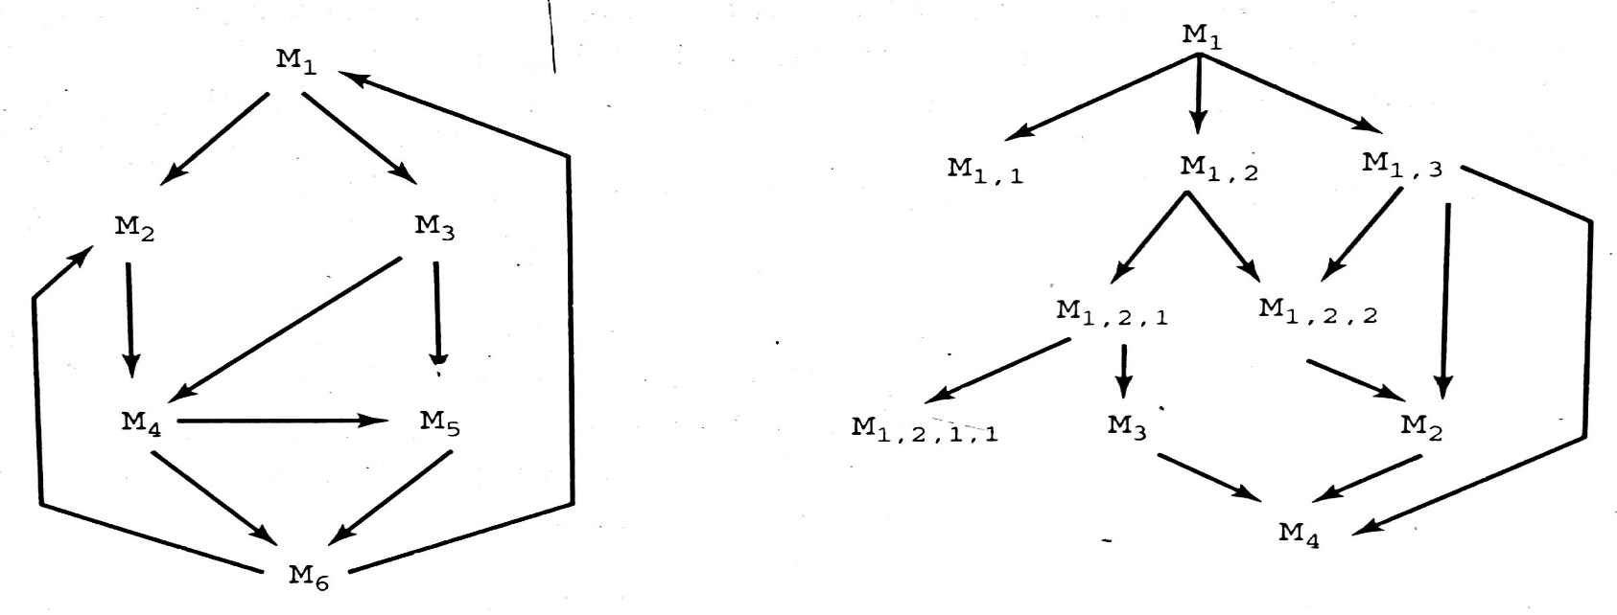
Contnd..
Graphical form
Directed Graph
Nodes – elements of S
Directed arc – relation between modules; M1 r M2
Hierarchy – if there is no cycle (Directed Acyclic Graph)
General Graph DAG

Slide 28
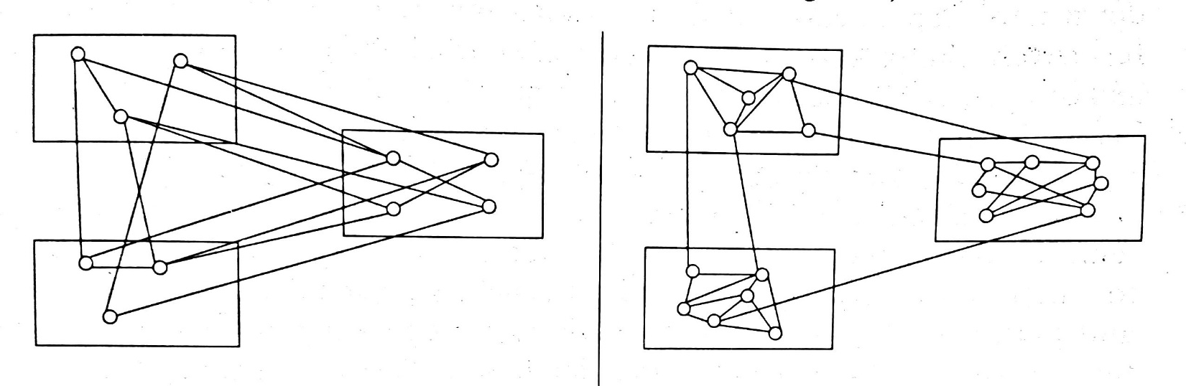
Coupling and Cohesion
Coupling
Measures the interdependence of two modules
Cohesion
Measures the interdependence of elements in a module
High Coupling High Cohesion and Low Coupling

Slide 29
Types of Relationships
USES
Mi USES Mj :- Mi requires the presence of Mj coz Mj provides the resources that Mi needs to accomplish its task.
Mi is a client of Mj (Server)
Mi Accesses a resource provided by module Mj
Eg: Mi contains a call to a procedure contained in Mj
It should be a hierarchy
Client components may be easily understood.
Separation of concern can be applied by traversing the USES structure,
Starting from the nodes that do not use any other nodes up to the nodes that are not used by any other node.
A cycle represents a strong coupling between all the modules in the cycle.

Slide 30
Contd..
Defines system through levels of abstraction.
A module at level i USES only modules at any level j such that i>j
Abstract Machine
At each level a module provides a set of services
Used by higher level modules.
Progressively detailed by relying on other VMs until no further levels are given.
Defined statically
Identification of pairs is independent of the execution of the s/w.
Eg: if cond then proc1 else proc2 (either one not both)

Slide 31
Contnd..
Picture about Coupling
Cardinality of r n(n-1); every module related to each other
R is empty; no two modules are related
fan-out – no of outgoing edges – low
fan-in – no of incoming edges – high

Slide 32
Contnd…
IS_COMPONENT_OF
A module that is composed of other modules that may themselves composed of other modules and so on.
Mi IS_COMPONENT_OF Mj
Mj is realized by aggregating several modules, one of them being Mi
The inverse of IS_COMPONENT_OF relation is COMPRISES
Mi COMPRISES Mj iff Mj IS_COMPONENT_OF Mi.
Mi IS_COMPOSED_OF Ms,i or Ms,i IMPLEMENTS Mi
Iff Ms,i ={Mk|Mk is in S and Mk IS_COMPONENT_OF Mi}
The modules of Ms,i provides all the services that Mi should provide.
Thus the system is decomposed into modules

Slide 33
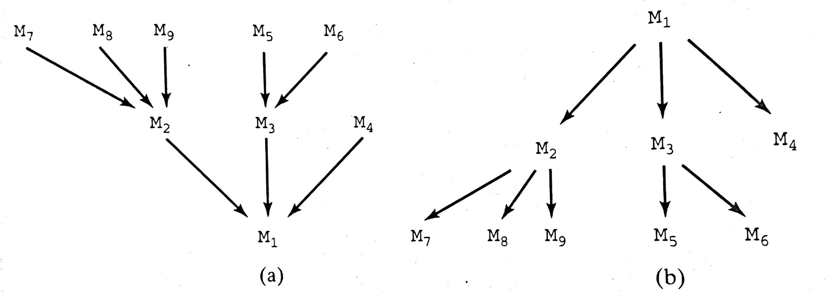
Graphical Representation
IS_COMPONENT_OF COMPRISES
If Mi IS_COMPOSED_OF{Mi,1, Mi,2,…..Mi,n} then Mi is a higher level module than any of {Mi,1, Mi,2,…..Mi,n}
The entire software system – M4, M5, M6, M7, M8 and M9

Slide 34
Contnd..
A module can be a component of more than one module.
When Mi is a component of both Mj & Mk:- Mi is a component of Mj and use a copy of Mi as a component of Mk
Defined as a macro or a template module and then generating instances to be used in the different contexts.
USES and IS_COMPONENT_OF can be used together
Eg: System is composed of modules M1,M2 and M3 where M1 uses both M2 and M3.
Specify M1 as composed of M4 and M5.
Changes in the module should not affect the product family.

Slide 35
Interface and Information Hiding
Divide the s/w into components such that each component can be designed independently (less Coupling).
Define the interaction among modules take place (nature of USES relation).
The set of services that each module provides to its clients is called its interface.
The services are exported by the module and imported by the clients.
The way these services are accomplished is embedded in the implementation.

Slide 36
Contnd..
Abstraction of the module as viewed by its clients.
The designer should know only the interfaces to other modules not their implementation.
Implementation of a module is
its decomposition in terms of components (IS_COMPONENT_OF)
if the module is simple, its representation in terms of code which possibly uses services from other lower level modules
The interface can be viewed as a Contract between module M and its clients.
Records all and only the facilities the designer in charge of M agrees to provide to other designers.

Slide 37
Contnd..
The interface describe computational resources
A variable that belong to a module and is made accessible to other modules to provide a form of interaction
Procedure (Function) that must be called to have some operation performed.
Also describes some nonfunctional aspects of an interface.

Slide 38
Contnd..
Information Hiding
The clients of a module know about its services only through interface; the implementation is hidden from them.
Implementation may change interface remains unchanged.
It should be defined precisely
What goes into the modules interface (visible to the clients) and
What remains hidden in the implementation and can be changed at any time without affecting the clients.

Slide 39
Contnd..
Design of module interface
Iceberg analogy
Risk of revealing unnecessary information,
Increase the complexity of the module.
Reduces understandability of design.
Changes may affect the interface.
Other module may do undesirable operations.
Make the module less usable.
Changeable hidden information becomes the secret of the module.
Encapsulated in the module implementation.

Slide 40
Design Notations
Textual Design Notation (TDN)

Slide 41
Contnd..
Graphical Design Notations (GDN)

Slide 42
Categories of Modules
Categorization of modules is a step towards the development of standard SE components.
Standard Categories:
Procedural Abstraction
Libraries
Common pool of data
General & Abstract Categories
Abstract Objects
Abstract data types
Generic Modules

Slide 43
Contnd..
Procedural Abstraction
Traditional form of Modularization
Module provides just a procedure/function which implements some abstract operation
Used to encapsulate an algorithm
e.g. sorting module, fast Fourier transform module, …
Libraries
A group of related procedural abstractions
e.g., libraries of mathematical routines
Implemented by routines of programming languages

Slide 44
Contnd..
Common pools of data
Data shared by different modules
Low level type of module
No abstraction
Details of data visible to all the clients
e.g., configuration constants
Static variable in C & Java

Slide 45
Abstract objects
Need to hide the details of data representations and shield clients from changes in them.
Objects manipulated via interface functions.
Exhibits a state
Looks like libraries
Have a permanent hidden, encapsulated data structure in their implementation part
Visible to routines that are internal to the module
Hidden from client modules
Values stored in a data structure changes from call to call
Results by two calls with same parameters may be different.
There is no difference in syntax of the interface of Abstract Object and library module. A comment is used for AO.

Slide 46
Contnd..
A calculator of expressions expressed in Polish postfix form
a*(b+c) → abc+*
A module implements a stack where the values of operands are shifted until an operator is encountered in the expression
(assume only binary operators & integer operands)
Interface of the abstract object STACK
exports
procedure PUSH (VAL: in integer);
procedure POP_2 (VAL1, VAL2: out integer);
Issues….

Slide 47
Abstract data types
Application may need more than one Abstract Object.
Define a type –> generate instances of it.
Need a way to
Need a set of procedure to manipulate the instances
Encapsulate the details of the type in the module.
Exports a type, along with the operations needed to access and manipulate objects of that type.
It hides the representation of the type and the algorithms used in the operations (Exported).
Client modules pass variables of the type in questions as parameters for proper manipulataion.

Slide 48
Contnd..
A stack ADT

Slide 49
Contnd..
May add notational details to specify if certain built-in operations are available by default on instance objects of the ADT
e.g., type A_TYPE: ? (:=, =) indicates that assignment and equality check are available.
 | ADT | AO
Instances | Any number | Single
State | No | Yes
Implementation (OOF) | Classes | Instances

Slide 50
Generic Modules
Extension of TDN – provides a tool for writing reusable components.
Provides a single description for all modules implementing an abstract object.
A module that is parameterized with respect to a type.
generic module GENERIC_STACK_2 (T)
uses . . .
exports
procedure PUSH (VAL : in T);
procedure POP_2 (VAL1, VAL2 : out T);
…
end GENERIC_STACK_2

Slide 51
Contnd..
It is a module template
Must be instantiated by providing actual parameters
module INTEGER_STACK_2 is GENERIC_STACK_2 (INTEGER)
Constraints must be specified in comments.
If the generic module requires its parameter type to support a particular operation; specify in the module header.
generic module M(T) with OP(T)
Uses …
.
.
End M
At instantiation time, actual procedure must be passes as parameters along with the type.
module M_A_TYPE is M(A_TYPE) PROC (M_A_TYPE)
Allows to factor several algorithms into a single, abstract, generic representation that is instantiated before being used.
Applies principle of generality – useful in families of programs.

Slide 52
Specific techniques for design for change
Use of configuration constants
The required changes in the s/w is factored out into a set of constants
The value of the constant can be changed instead to make many changes.
Grouped together in a module that provides a common pool of data, which can be accessed by any client.
E.g. symbolic constants in C, C++, Java….
Conditional compilation
All versions are represented by one single source copy and the difference between various versions are taken into account by conditional compilation.
Compiler recognizes with bracketed macro commands with versions.
When compiler is invoked;
Parameter is specified to produce a particular version
Ignores source statements that are not part of the proper version

Slide 53
Contnd..
Software Generation
Solution is generated automatically.
Used in restricted application domains.
E.g. yacc : generates part of a compiler to make the source language is not frozen
Generating interfaces.

Slide 54
Stepwise Refinement
Most popular systematic approach to program design and validation
Iterative process
Problem to be solved is decomposed into sub-problems (Solved separately) at each step
The sub-solutions linked together by means of simple control structures.
Sub-solutions may be executed
In a sequence
Selected alternatively
May be iterated in a loop

Slide 55
Contnd..
E.g,At each step, problem P decomposed into
sequence of sub-problems: P1; P2; …Pn
a selection: if (cond) then P1 else P2
an iteration: while (cond) loop P1; end loop
Alternatively CASE statement also can be used.
Usually expressed in terms of Natural Language like description
Each refinement step is represented by
Rewriting NL description in terms of sub-problem statements glued with the control structure represented by the foregoing patterns.
Detailed at each refinement step.

Slide 56
Contnd..
Design Process
Starts with an overall description of the problem
Recursively applies functional decomposition
Terminates at appoint where each sub-problem is easy to express in terms of a few lines of code in the chosen programming language

Slide 57
Contnd..
Stepwise refinement process may be depicted by a decomposition tree (DT)
Root labeled by name of top problem
Subproblem nodes labeled as children of parent node corresponding to problem
Children from left to right represent sequential order of execution
Nodes representing alternative sub-problem are identified by a dotted line groups the arc that connects the nodes to their parent node.
Arcs are labeled by the condition
Iteration is represented by a solid line, to which the condition governing the while structure is labeled.

Slide 58
Example
Step 1
P; P problem to solve
Step 2
P1; P2; P3; P decomposed into sequence
Step 3
P1;
while C loop
P2,1; P2 decomposed into a loop
end loop;
P3;
Step 4
P1;
while C loop
if C1 then P2,1 decomposed into selection
P2,1,1;
else
P2,1,2;
end if;
end loop;
P3;

Slide 59
Corresponding DT

Slide 60
Contnd..
Relation with IS_COMPOSED_OF
Let M, M1, M2, M3 be modules representing P, P1, P2, P3
We cannot write
M IS_COMPOSED_OF {M1,M2,M3}
We need to add a control module acting as glue to impose a sequential flow from M1 to M2 to M3
M IS_COMPOSED_OF {M1,M2,M3,M4}
IS_COMPOSED_OF relation does not correspond to a meaningful modularization.
Stepwise refinement describes the logical structure of an algorithm implemented by a module than the decomposition of system into modules.

Slide 61
An assessment of stepwise refinement
Stepwise refinement is a program documentation technique, not a modularization technique
The resulting code following stepwise refinement will be easy to read and understand.
Effective for describing small programs.
It fails to scale up to systems of even moderate complexity.

Slide 62
Contnd..
Reasons for shortcomings.
When used to decompose system into modules, it tends to analyze problems in isolation, not recognizing commonalities.
No scope of reuse.
It does not stress information hiding
Stress is only on the readability of the resulting solution.
No attention is paid to data
Assumes that a top function exists
But which one is it in the case of an operating system? or a word processor?
Enforces premature commitment to control flow structures among modules

Slide 63
Top-Down Vs. Bottom-Up
Top – Down Design
Design proceed from Top to Bottom,
By recursively applying decomposition through IS_COMPOSED_OF
Until we break down the system into manageable components.
Stepwise refinement is an intrinsically top-down method.
Issues…
The Top-Down approach is useful to document a design.

Slide 64
Contnd..
Bottom – Up Design
Proceed from Bottom to Top
Information hiding proceeds bottom-up
Starting from what to be encapsulated within a module,
Recursively defining an abstract interface
Defines the module boundaries.
Then grouping together several modules to form a new.
What to hide inside a module.
May depend on the result of some top-down design activity.

Slide 65
Contnd..
Design is a highly critical and creative human activity
No actual design does not proceed in either a strictly top-down or strictly bottom-up fashion.
A typical design strategy may proceed partly from the top-down and partly from the bottom-up depending up on
The phase of design or the nature of the application being designed.
Even though the design is in a combined fashion the description of the resulting design is recommended to be in a top-down fashion for better understandability
Gives the big picture before showing the supporting details.

Slide 66
Handling Anomalies
Any engineering product is prone to failure.
The designer must anticipate failures and plan to;
Either avoid
Or tolerate them
Known as Defensive Design
Shield the application from errors that may
Creep in during development or
That may arise due to adverse circumstances during program execution.
Should build Robust systems

Slide 67
Contnd..
A module is anomalous if it fails to provide the service as expected and as specified in its interface
Design notations are extended with a set of exceptions with each service exported by the module.
The exceptions associated with a service denote the anomalies that may occur while the service is being performed.
Exception MUST be raised when anomalous state is recognized

Slide 68
How can failures arise?
Module M should fail and raise an exception if
One of its clients does not satisfy the required protocol for invoking one of M’s services
M does not satisfy the required protocol when trying to use a service exported by another module.
M may fail to provide service because of an unforeseen condition.
Eg: overflow of an array.
Hardware generated exception (e.g., division by zero)

Slide 69
What a module can do before failing
Before failing, modules may try to recover from the anomaly by executing some exception handler (EH)
EH is a local piece of code that may try to recover from anomaly (if successful, module does not fail)
or may simply do some cleanup of the module’s state and then let the module fail, signaling an exception to its client

Slide 70
Tabular Design Notation
Decision tables provide a notation that translates actions and conditions (described in a processing narrative) into a tabular form.
The table is difficult to misinterpret and may even be used as a machine readable input to a table driven algorithm

Slide 71
Contnd..
The table is divided into four sections.
The upper left-hand quadrant contains a list of all conditions.
The lower left-hand quadrant contains a list of all actions that are possible based on combinations of conditions.
The right-hand quadrants form a matrix that indicates condition combinations and the corresponding actions that will occur for a specific combination.
Therefore, each column of the matrix may be interpreted as a processing rule.

Slide 72
The following steps are applied to develop a decision table:
List all actions that can be associated with a specific procedure (or module).
List all conditions (or decisions made) during execution of the procedure.
Associate specific sets of conditions with specific actions, eliminating impossible combinations of conditions; alternatively, develop every possible permutation of conditions.
Define rules by indicating what action(s) occurs for a set of conditions.

Slide 73
Example
If the customer account is billed using a fixed rate method, a minimum monthly charge is assessed for consumption of less than 100 KWH (kilowatt-hours). Otherwise, computer billing applies a Schedule A rate structure. However, if the account is billed using a variable rate method, a Schedule A rate structure will apply to consumption below 100 KWH, with additional consumption billed according to Schedule B.

Slide 74
Program Design Language
Program design language (PDL), also called structured English or pseudocode, is "a language in that it uses
The vocabulary of one language (i.e., English)
The overall syntax of another (i.e., a structured programming language)
The difference between PDL and a real programming language lies in the use of narrative text (e.g., English) embedded directly within PDL statements.
Given the use of narrative text embedded directly into a syntactical structure, PDL cannot be compiled.
PDL tools currently exist to translate PDL into a programming language “skeleton” and/or a graphical representation (e.g., a flowchart) of design.

Slide 75
Characteristics
A fixed syntax of keywords that provide for all structured constructs, data declaration, and modularity characteristics.
A free syntax of natural language that describes processing features.
Data declaration facilities that should include both simple (scalar, array) and complex (linked list or tree) data structures.
Subprogram definition and calling techniques that support various modes of interface description.

